Slide 1
CAPSTONE PROJECT
Pytest · Robot Framework · Postman · Python · Selenium

Slide 2

Group Members
Bollavaram Harika
Thulasimogga Bhanu Prasad
Chinnarangareddy Gari Omkarnath Reddy
B.Tech (ECE)
B.Tech (ECE)
B.Tech (IT)
Peddireddi Neeraja
Sathi Abhinay Reddy
Singireddy Vikram
B.Tech (CSE)
B.Tech (CSE)
B.Tech (CSE)

Slide 3




Tools
Pytest
Robot
Automation testing using pytest
Automation testing using Robot
Generating API
POSTMAN
Generating API Using Flask
Validating APIs

Slide 4


PROJECT
PROJECT 01
UI Automation

Slide 5

TESTING FRAMEWORKS
Multi-Framework Automation Testing
Leveraging industry-leading frameworks to deliver robust, scalable, and maintainable test automation solutions.
Pytest Framework
Robot Framework
Powerful Python-based testing framework with rich plugin support, fixtures, and parametrize capabilities for scalable test suites.
Keyword-driven acceptance testing framework enabling readable test cases and seamless integration with web, API, and desktop automation.

Slide 6






Problem Statement
Features Validation
Cross-Browser Challenges
The website includes essential features like registration, login, product search, cart, checkout, and logout that must work correctly.
Ensuring compatibility across browsers like Chrome and Firefox adds complexity.
Manual Testing
Lack of Structured Framework
Manual testing of these workflows takes significant time and effort.
Without automation frameworks, test scripts become difficult to maintain and reuse.
Risk of Human Errors
Limited Reporting & Debugging
Repeated manual execution increases the chances of mistakes, especially after updates.
Absence of proper reporting and logging makes failure tracking and debugging difficult.

Slide 7
Project Overview
Project
Type
Tools & Technologies
Outcome
Pytest Automation Framework
Automation (Pytest)
Python, Requests Library, Pytest
Built re-usable scripts with Automated Report
Robot Automation Framework
Automation (Robot)
Robot Framework, Requests Library
Keyword, data driven testing of full app workflow

Slide 8

PART 01
UI Automation with Pytest

Slide 9
Objective
Key Activities
To automate web application testing using Python and Pytest in order to achieve faster execution, improved accuracy, and reliable regression results compared to manual testing.
Developed automated test scripts using locators with Pytest.
Implemented Pytest fixtures for efficient setup and teardown management.
Applied parameterization and assertions to create robust and reusable test cases.
Captured screenshots for failed test scenarios to aid debugging.
Generated detailed HTML test reports for result analysis and documentation.
Designed tests using a structured framework approach (Page Object Model).

Slide 10






Technologies Used
Python
Pytest
HTML
Outcomes
Successfully automated multiple critical web application scenarios, significantly reducing manual testing effort and execution time.
Improved test accuracy and consistency through structured automation using Pytest and Selenium.
Generated comprehensive HTML reports with detailed results, enhancing visibility, debugging efficiency, and overall testing reliability.

Slide 11
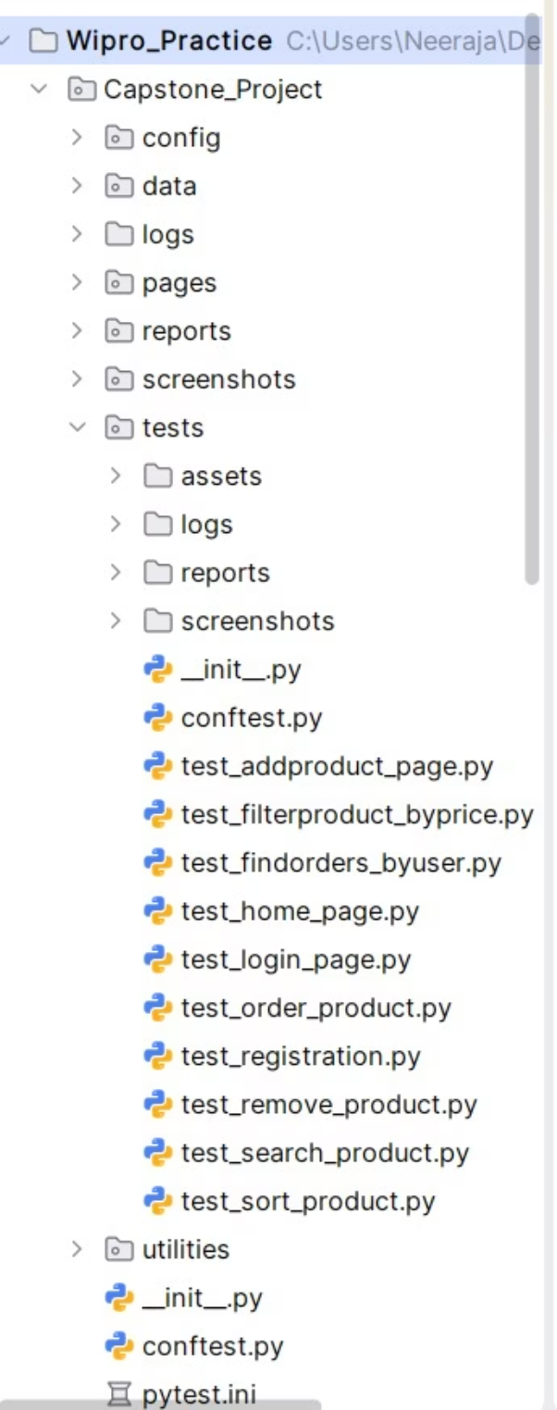










Folder Structure
Test Modules
Registration
Login
Search Product
Add Product
Remove Product
Order Product
Sort Product
Filter Order by User
Filter Order by Price
Logout

Slide 12
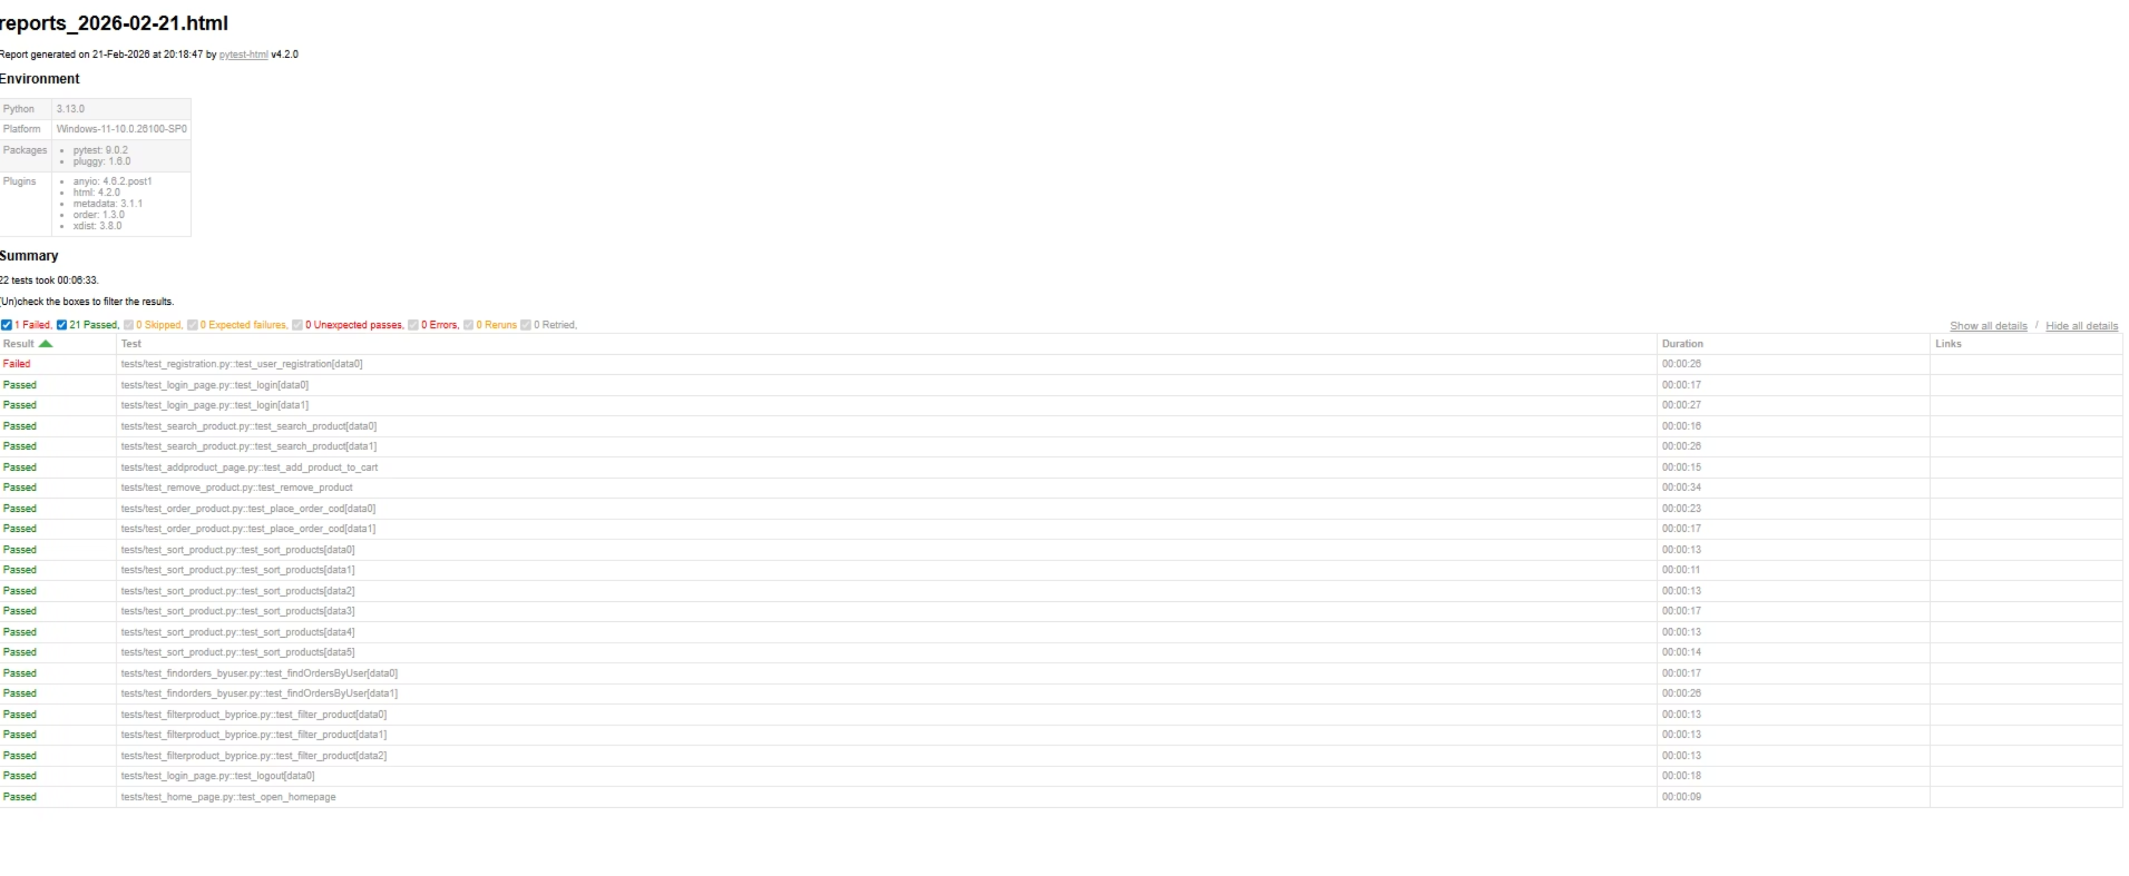
HTML Report

Slide 13
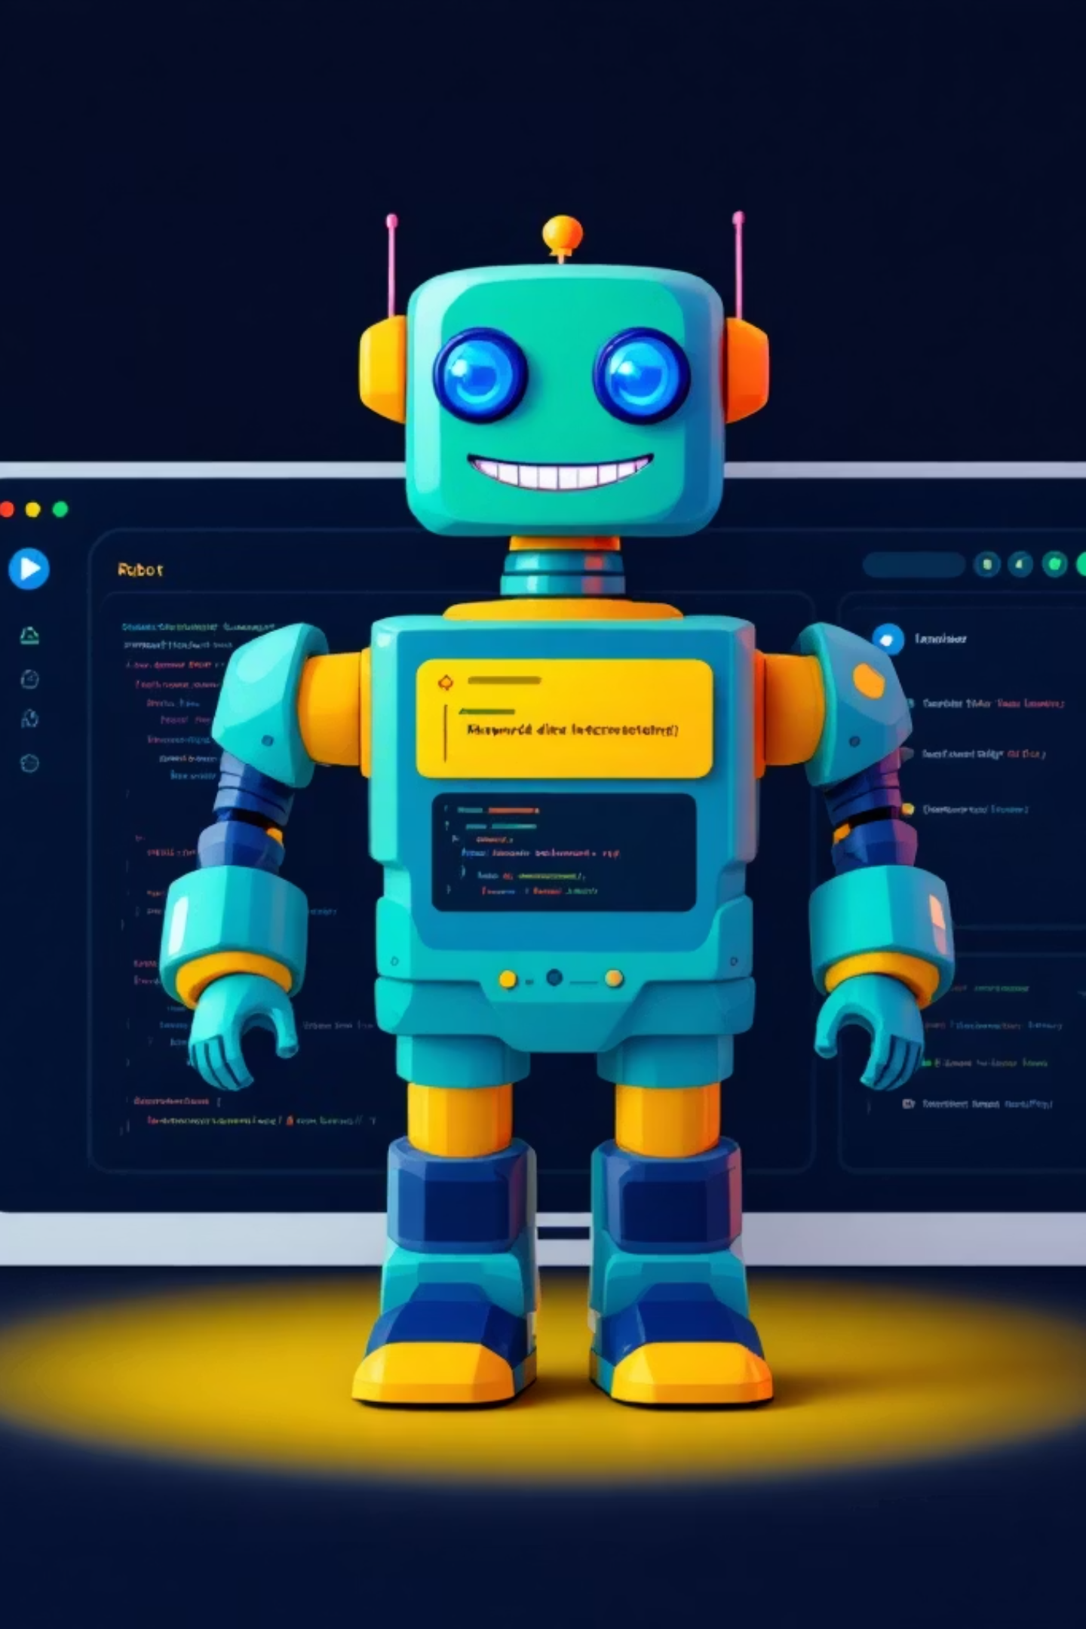
PART 02
UI Automation with Robot Framework

Slide 14
UI Automation with Robot Framework
🎯 Objective
To automate web application testing using Robot Framework for faster execution, improved accuracy, and reliable validation of application functionality.
1
2
3
Reusable Keyword Design
Data-Driven Testing
Reporting & Screenshots
Developed automated test cases using Robot Framework with SeleniumLibrary, implementing reusable keywords for modular and maintainable test design.
Applied data-driven testing techniques to ensure flexible, scalable, and comprehensive test coverage.
Enabled automatic screenshot capture for failures and generated detailed built-in HTML reports and logs for clear test result analysis.

Slide 15




Technologies Used
Python
Robot Framework
HTML
Selenium Library
Outcomes:
Successfully automated multiple critical web application scenarios
Reduced manual testing effort and improved execution speed
Enhanced test readability, maintainability, and reporting visibility
Improved overall efficiency and reliability of the testing process

Slide 16
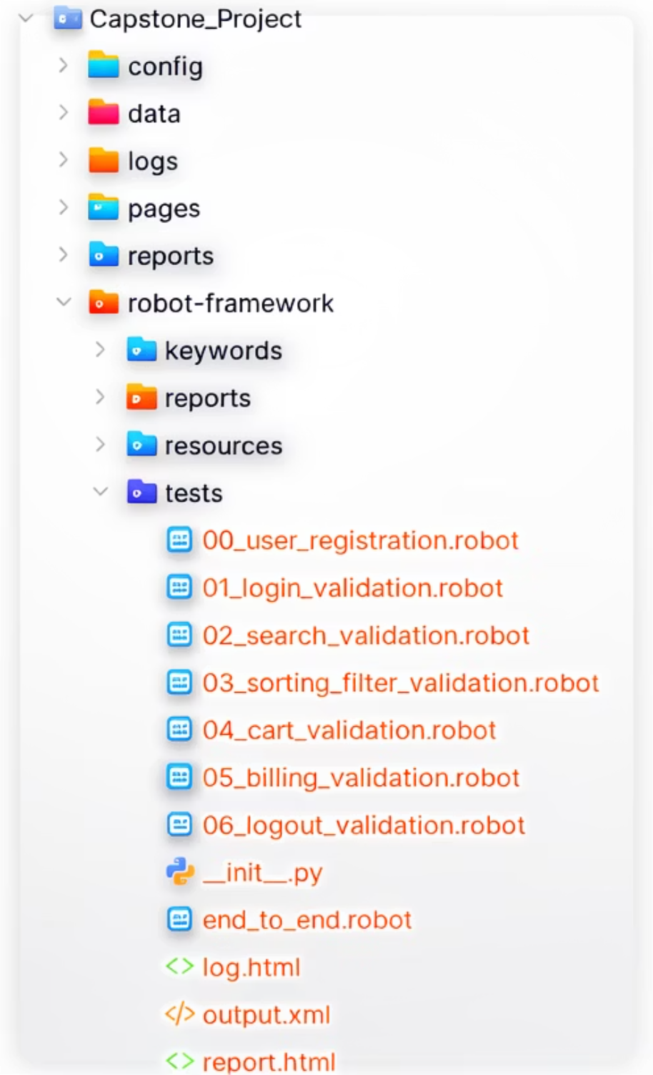







Folder Structure
Test Modules
Registration
Login
Search
Sorting
Cart Validation
Billing Validation
Logout

Slide 17
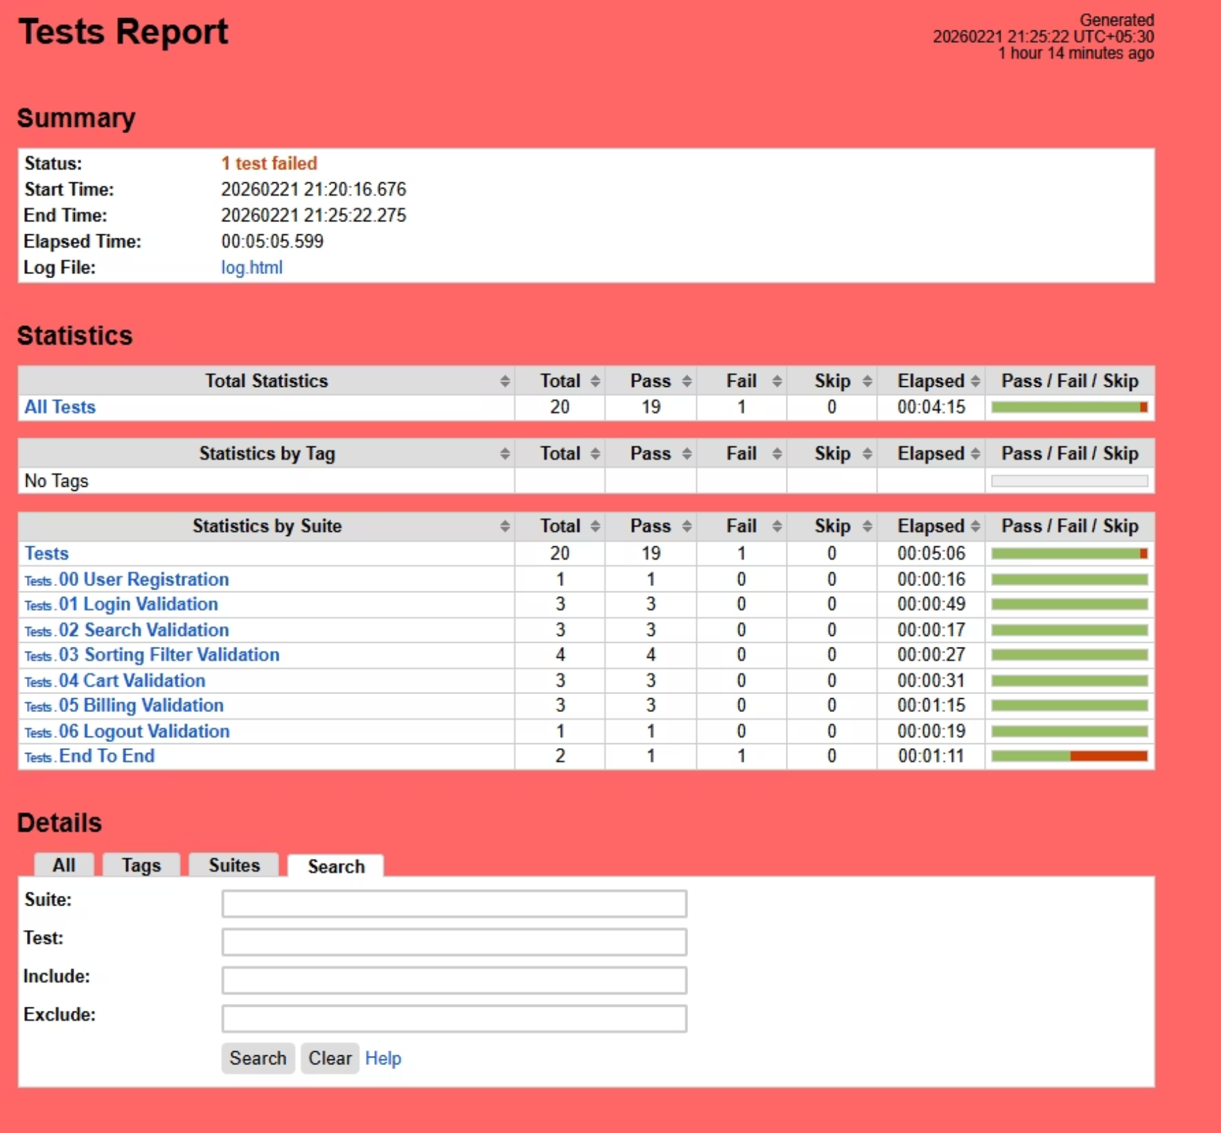
HTML Report

Slide 18
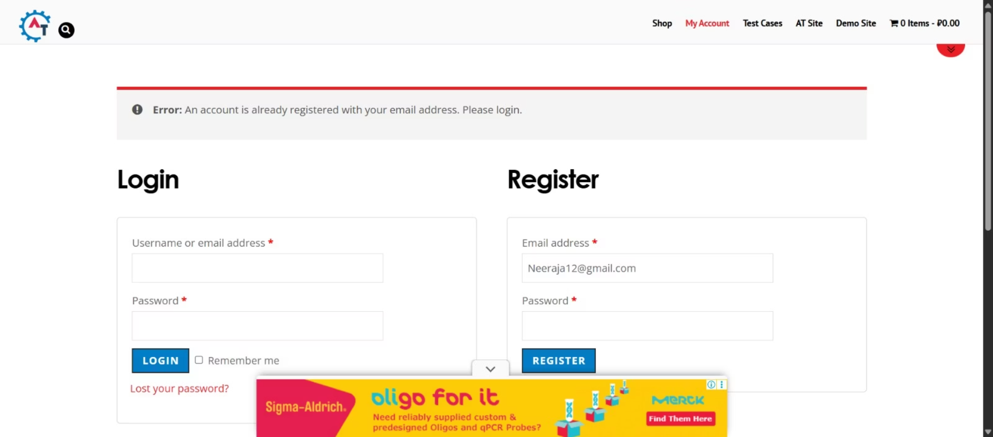
Failed Test Case for both Pytest and Robot

Slide 19





Challenges Faced During UI Automation Testing
Interacting with elements (like a "Success" message) during assertion
Elements with IDs or Classes that change on every page refresh (common in e-commerce sites).
During automation testing, elements inside an iframe were not accessible, causing NoSuchElementException and interaction failures.
Tests failing because a previous test left an item in the cart or didn't log out.

Slide 20

How Challenges are Solved
01
Implemented Expected conditions to wait specifically for the visibility or presence of text before proceeding with assertions.
02
Used Advanced XPath & CSS Selectors like contains() or starts-with() and relied on stable parent-child relationships rather than volatile IDs.
03
We resolved it by disabling iframe loading via browser options in conftest.py (or alternatively by switching to the iframe using driver.switch_to.frame()).
04
Leveraged Pytest Fixtures with "Setup" and "Teardown" logic. This ensures every test starts with a clean browser session and a fresh state.

Slide 21
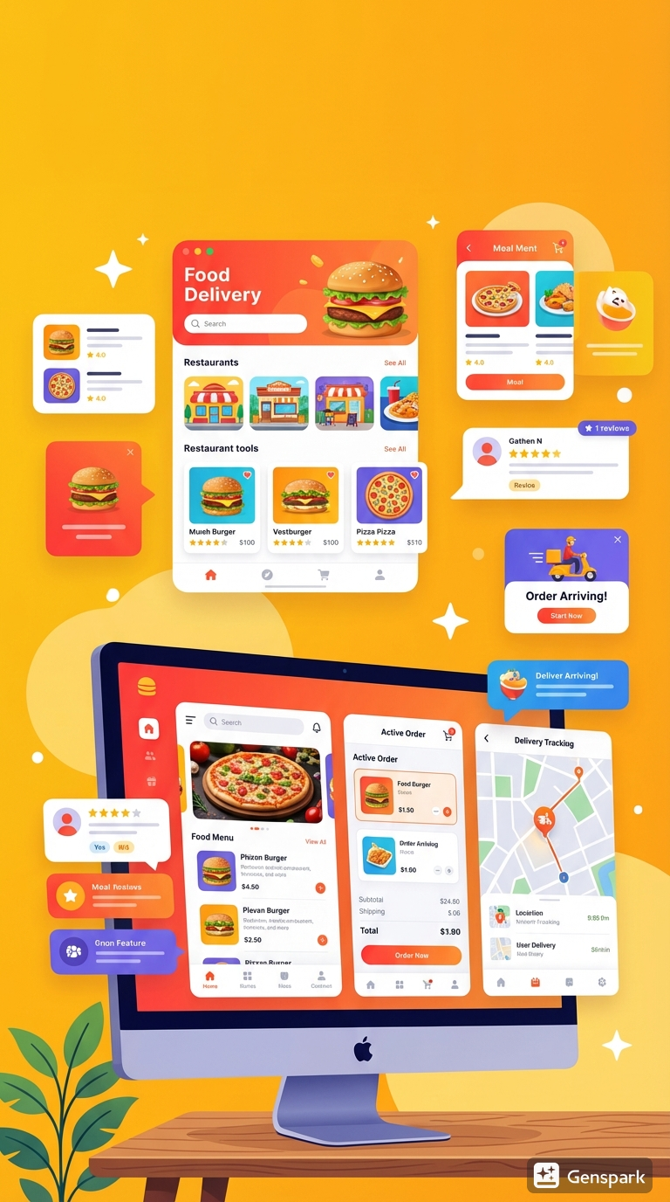
PROJECT
PROJECT 02
API Automation

Slide 22
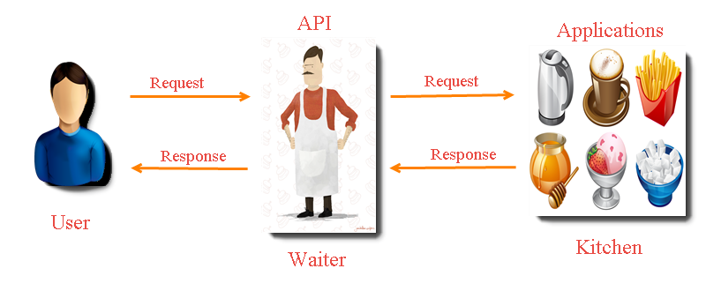
Foodie APP

Slide 23
Project Overview
Project
Type
Tools & Technologies
Outcome
Manual Testing using Postman
Postman
Validated URL endpoints and response data
Manual Testing
Pytest Automation Framework
Python, Requests Library, Pytest
Validated Status code and Schema
Automation (Pytest)
Robot Automation Framework
Robot Framework, Requests Library
Keyword, data driven testing of full app workflow
Automation (Robot)

Slide 24
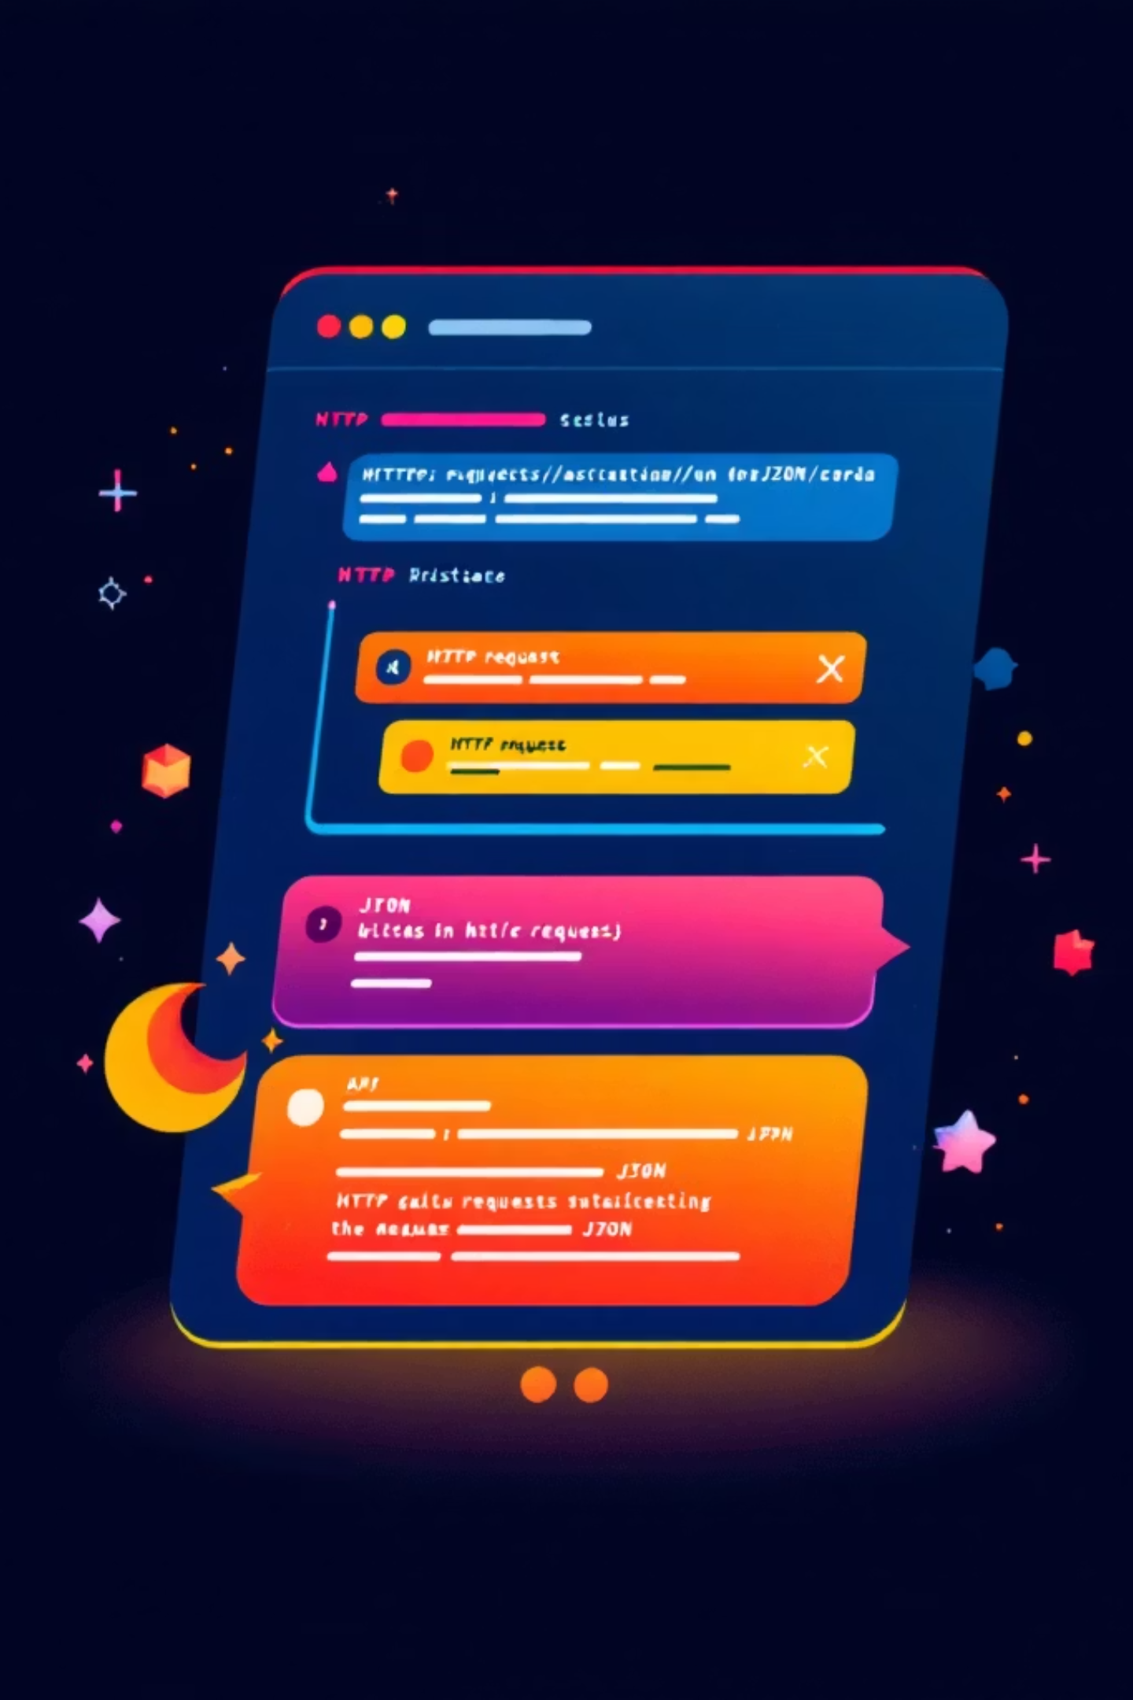
PART 03
API Testing using POSTMAN
Exploring API endpoints, validating responses, and streamlining workflows using Postman's powerful testing environment.

Slide 25




HTTP Methods
The 4 most commonly used HTTP methods for interacting with resources in a RESTful API.
GET
POST
Read-only access to a resource
Create a new resource
Use case: Retrieve a member or data from the server without modifying it.
Use case: Submit data to create a new entry on the server.
PUT
DELETE
Update or create a resource
Remove a resource
Use case: Replace an existing resource or create a new one if it doesn't exist.
Use case: Permanently delete a specified resource from the server.

Slide 26




Problem Statement
What is Foodie App?
Key Features
A digital platform designed for seamless food ordering, connecting users with a variety of restaurants and dishes.
Restaurant registration
Dish management
User profiles
Order placement
The Challenge
The Solution
Manual testing of complex, interconnected REST APIs is time-consuming, prone to human error, and difficult to scale with frequent application updates.
Automated testing using Pytest, Robot Framework to ensure the accuracy and reliability of API responses.

Slide 27
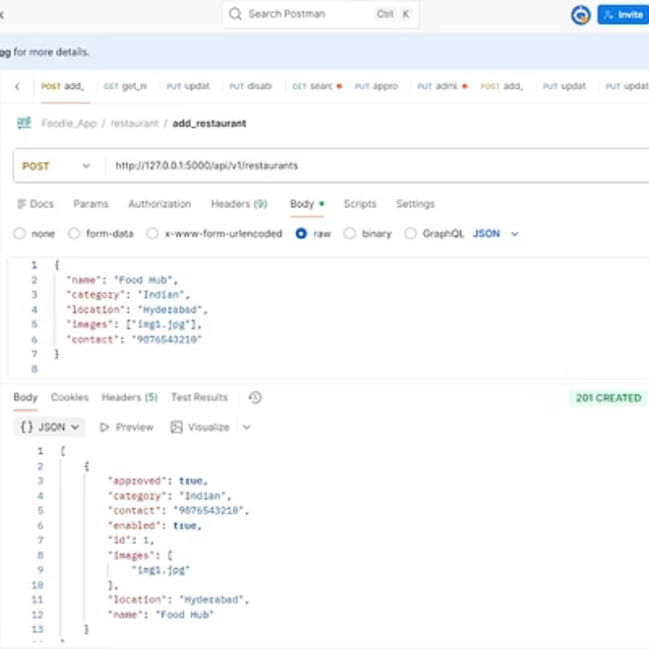
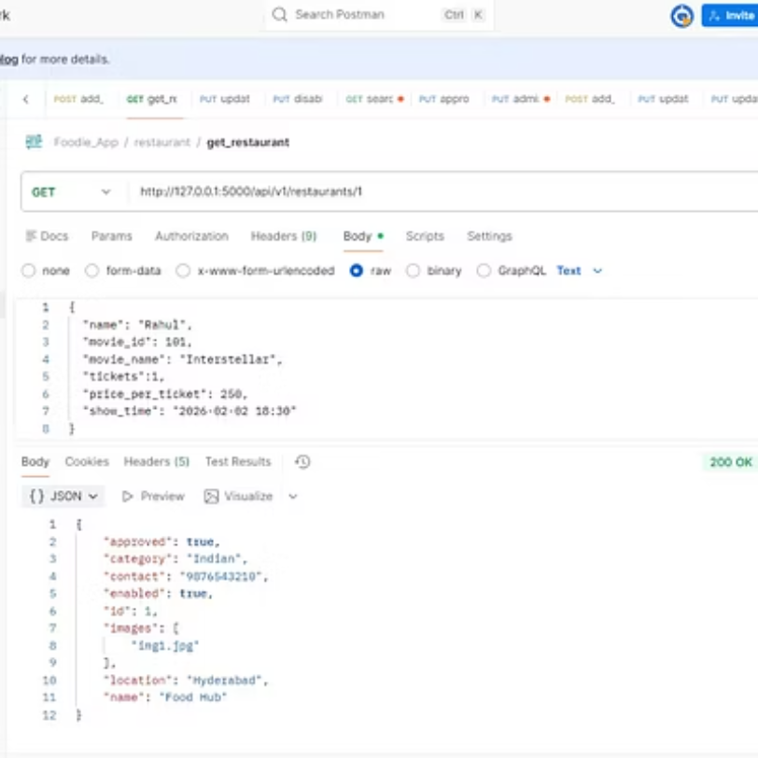
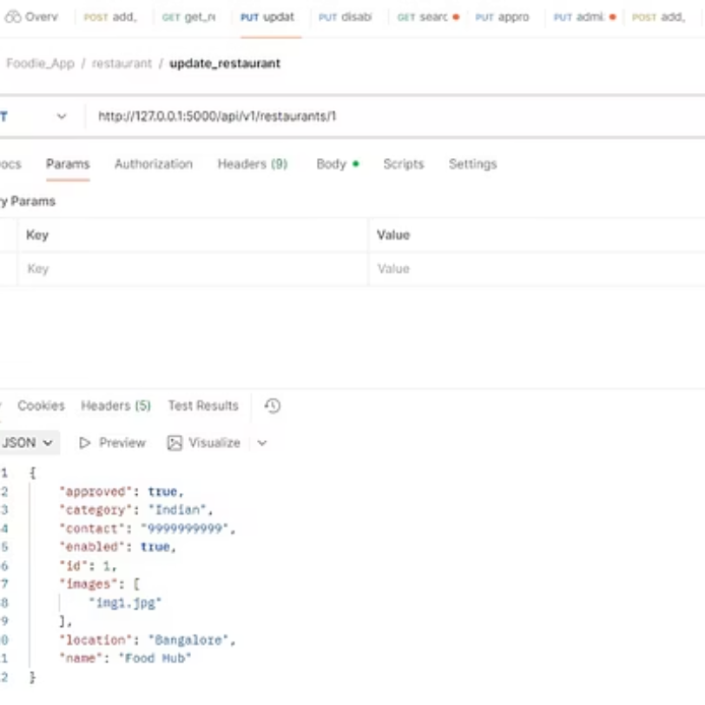
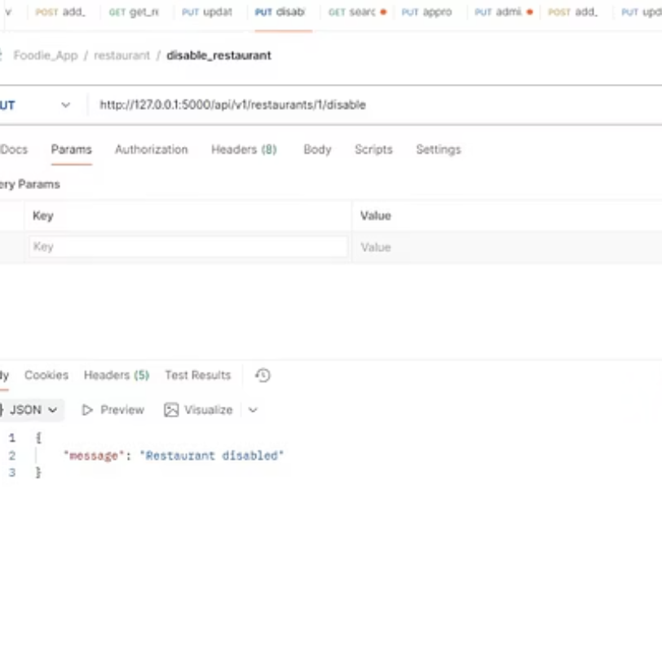
Restaurant Module

Slide 28
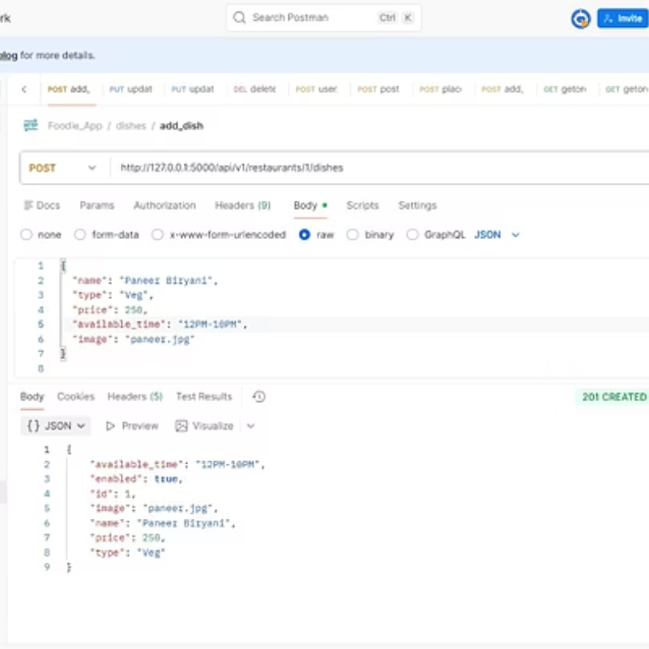
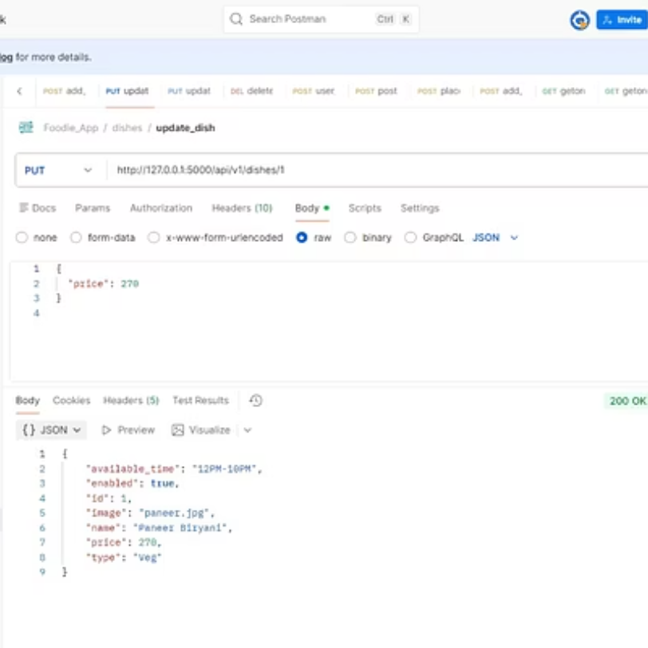
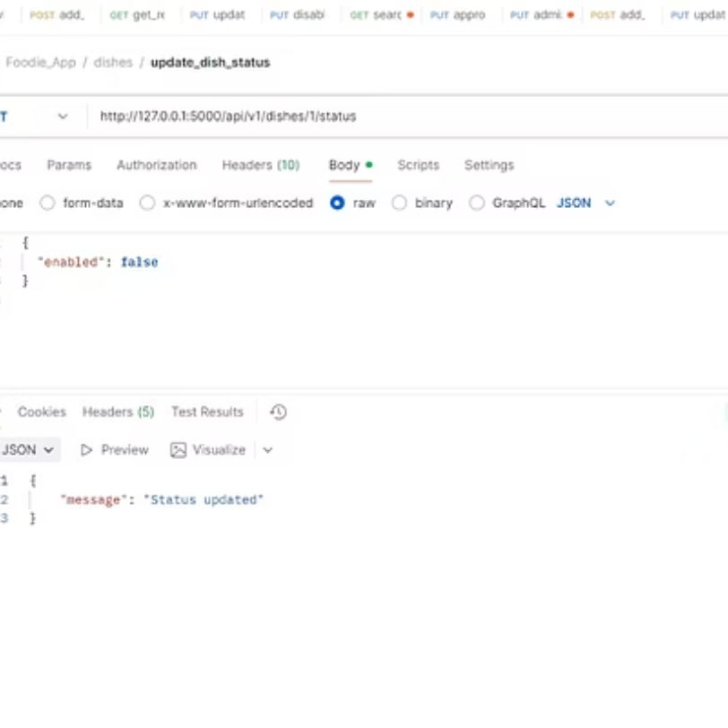
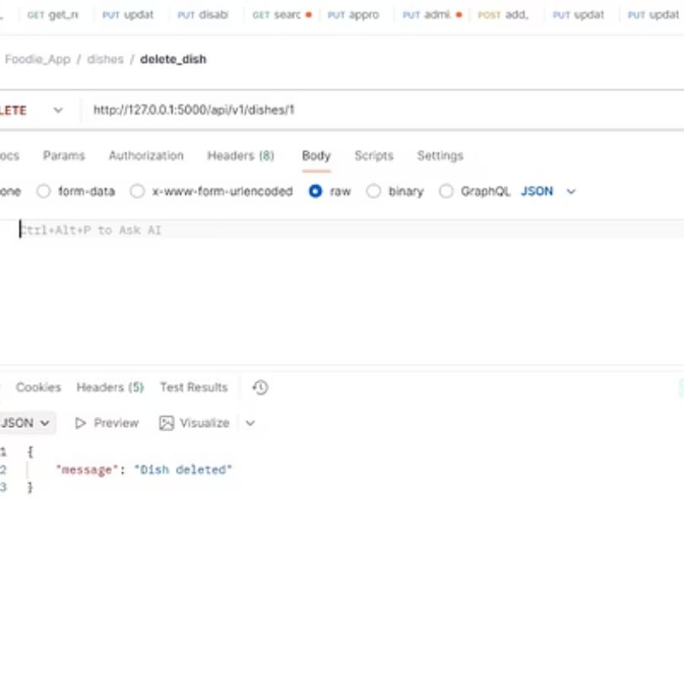
Dish Module

Slide 29
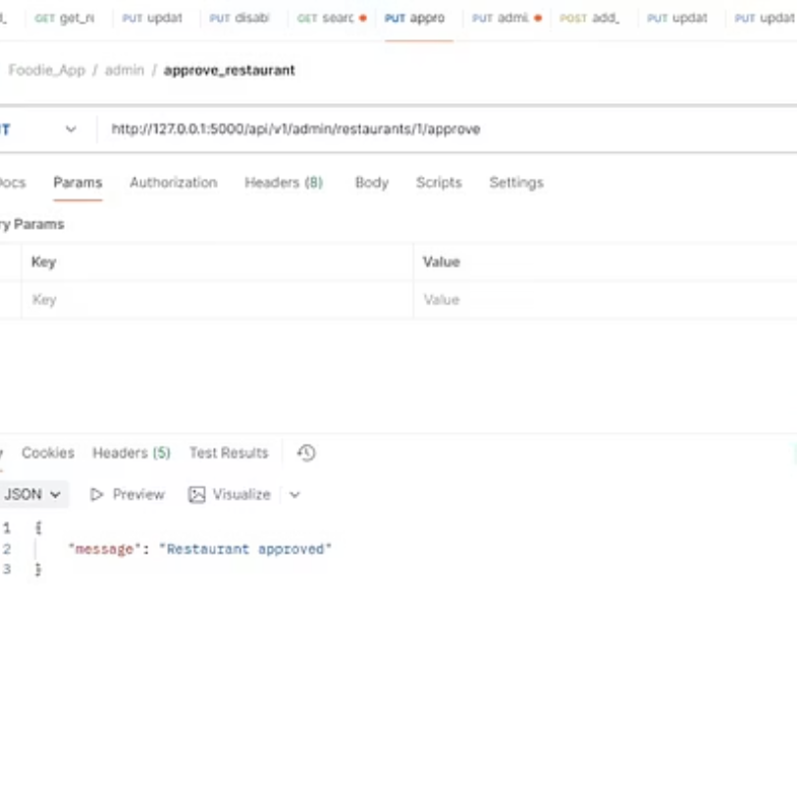
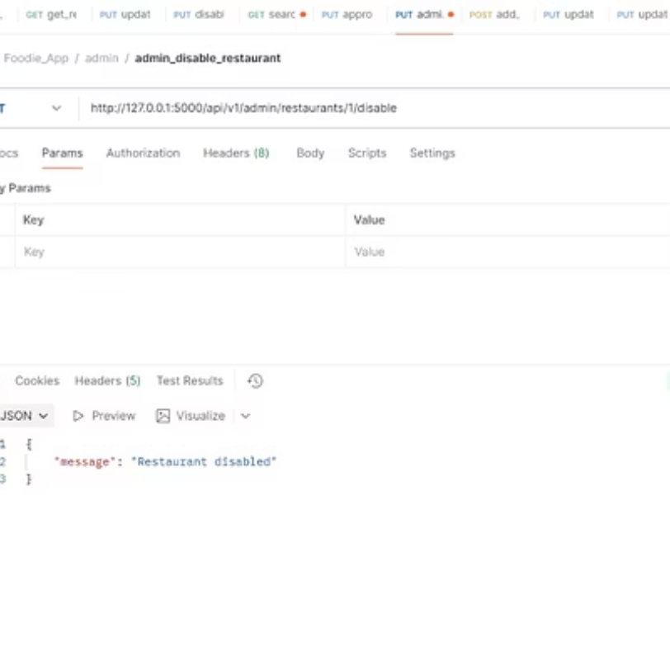
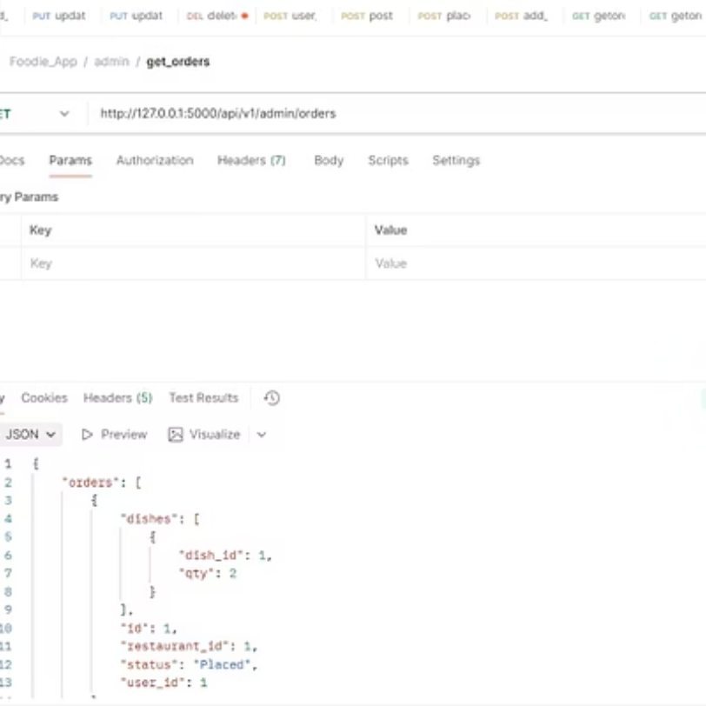
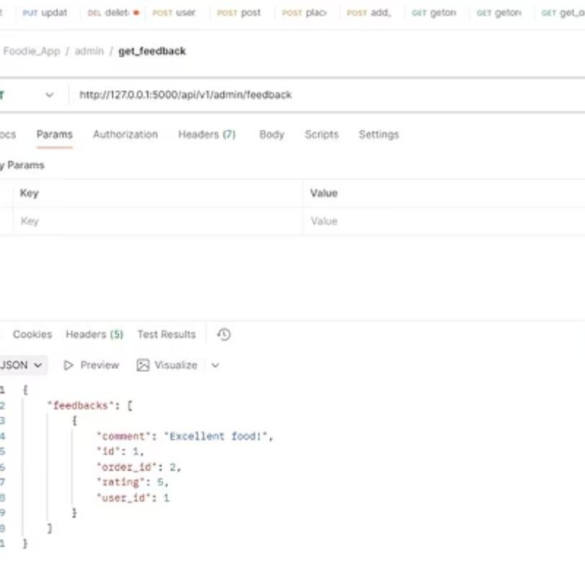
Admin Module

Slide 30
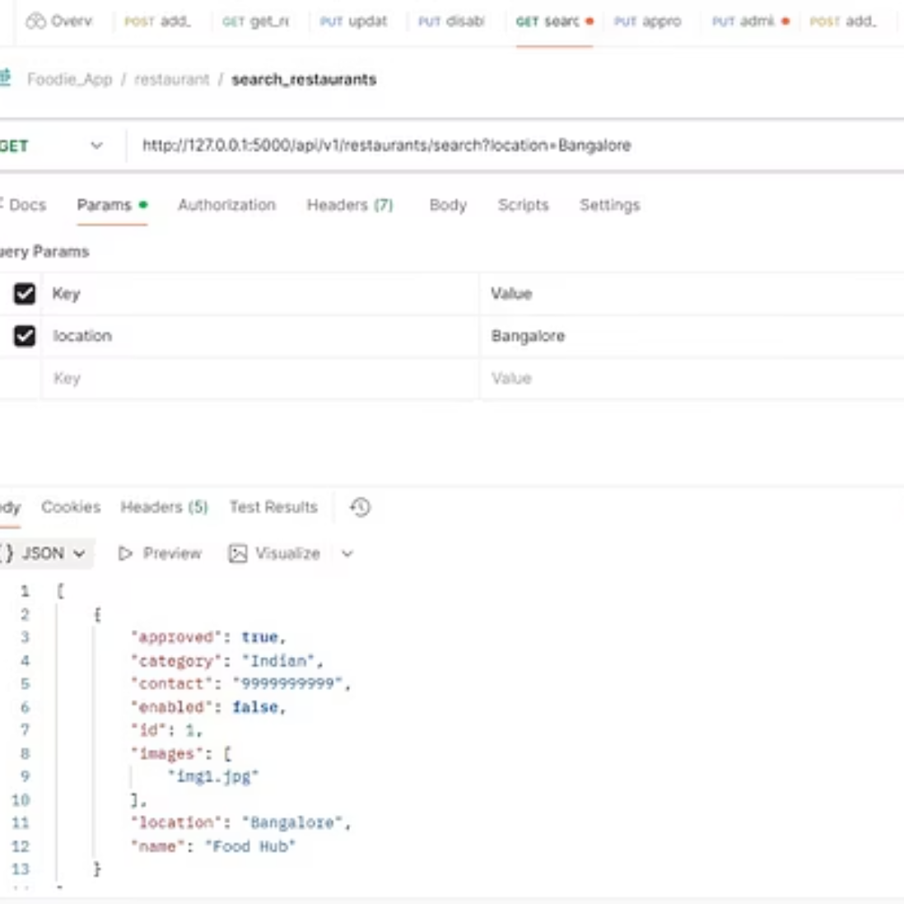
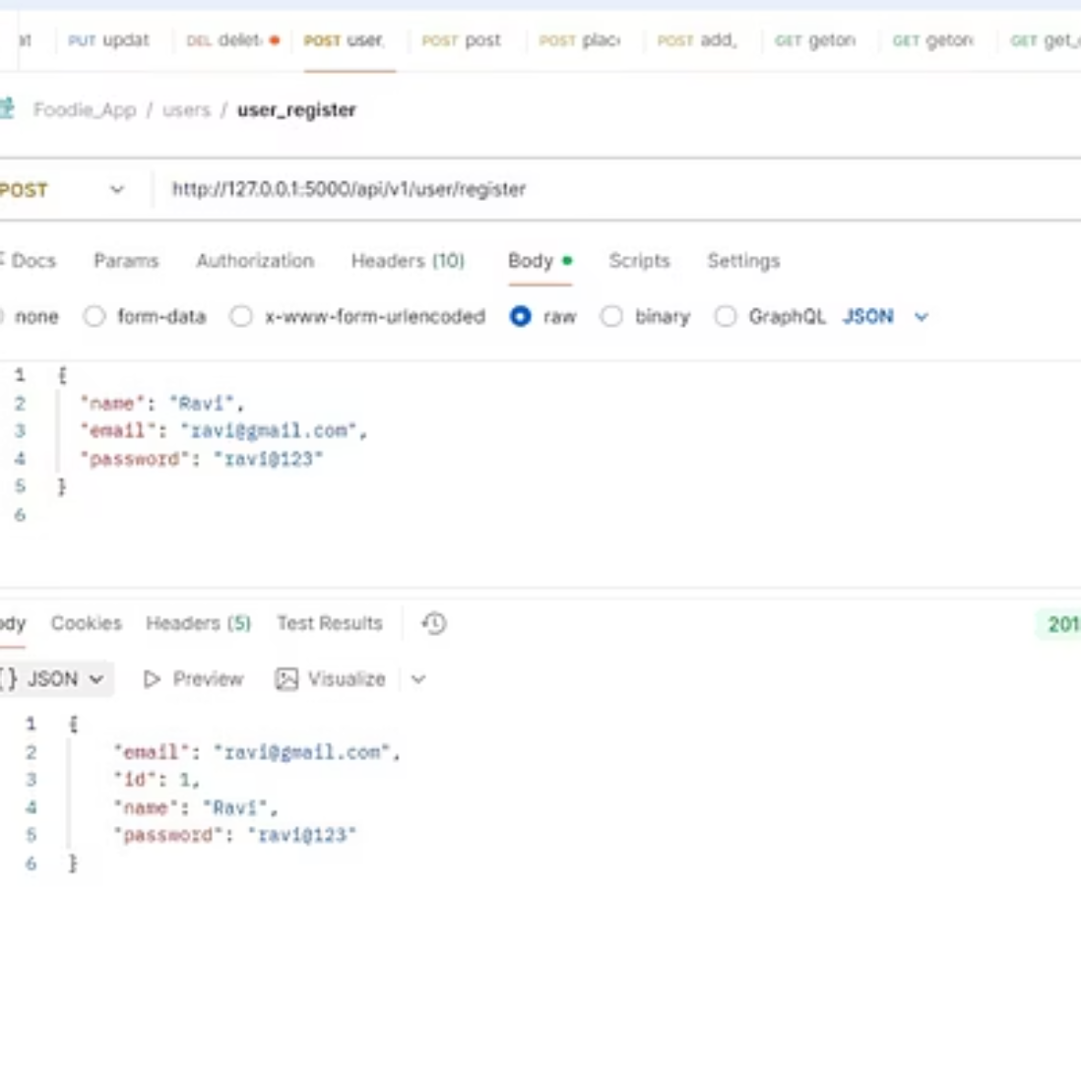
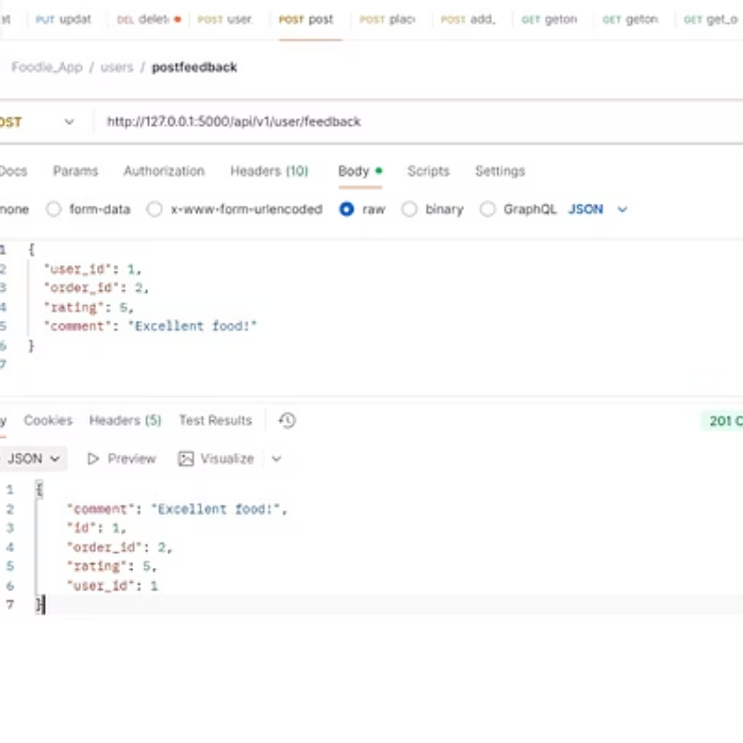
User/Customer Module

Slide 31
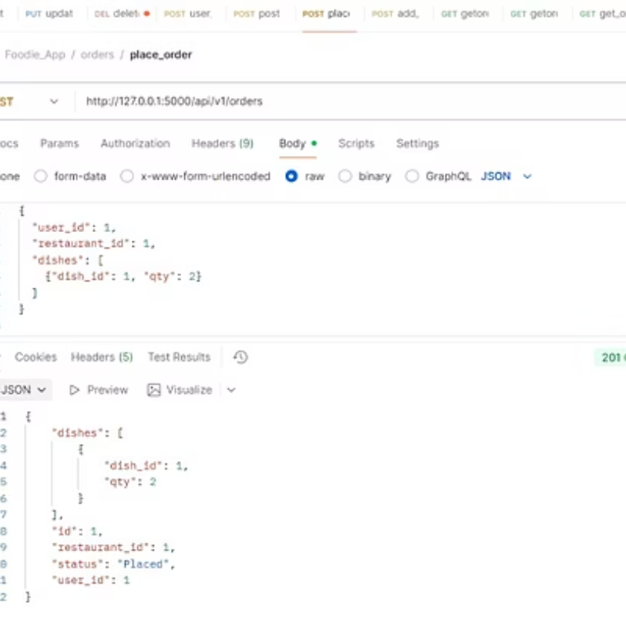
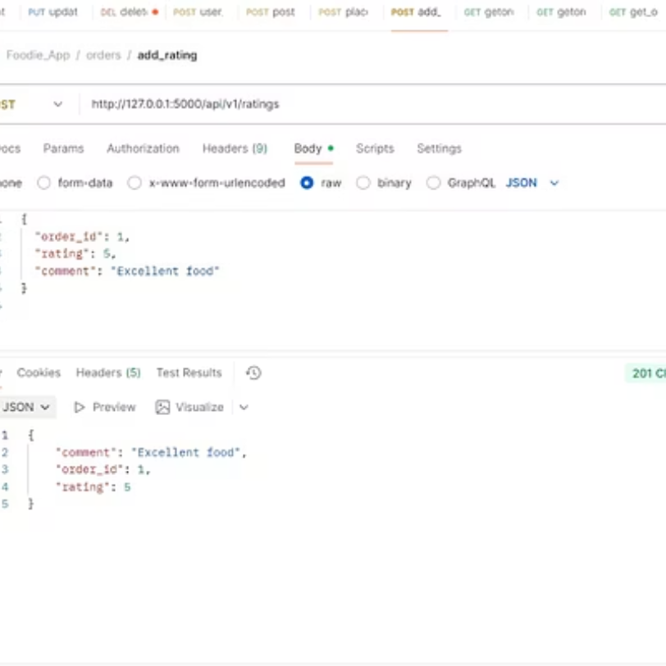
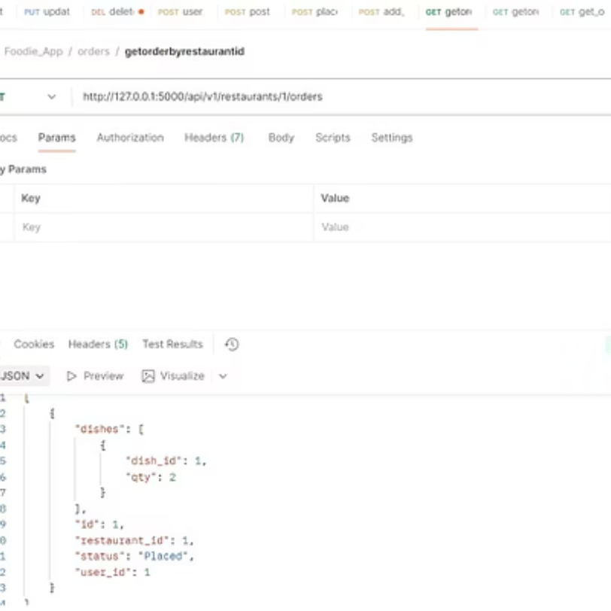
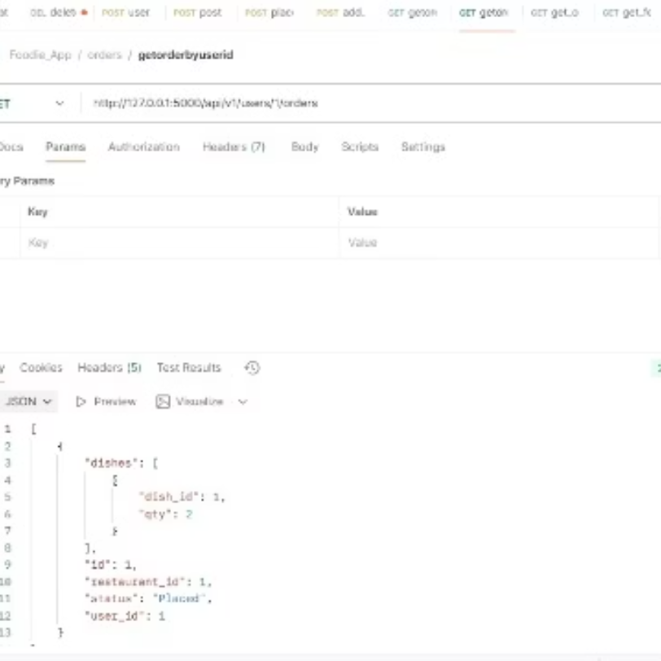
Order Module

Slide 32
Project 3: Foodie App - Postman Testing
Pytest Automation Framework
Robot Automation Framework
Type: Automation (Pytest)
Type: Automation (Robot)
Tools & Technologies: Python, Requests Library, Pytest
Tools & Technologies: Robot Framework, Requests Library
Outcome: Built re-usable scripts with Automated Report
Outcome: Keyword, data driven testing of full app workflow

Slide 33
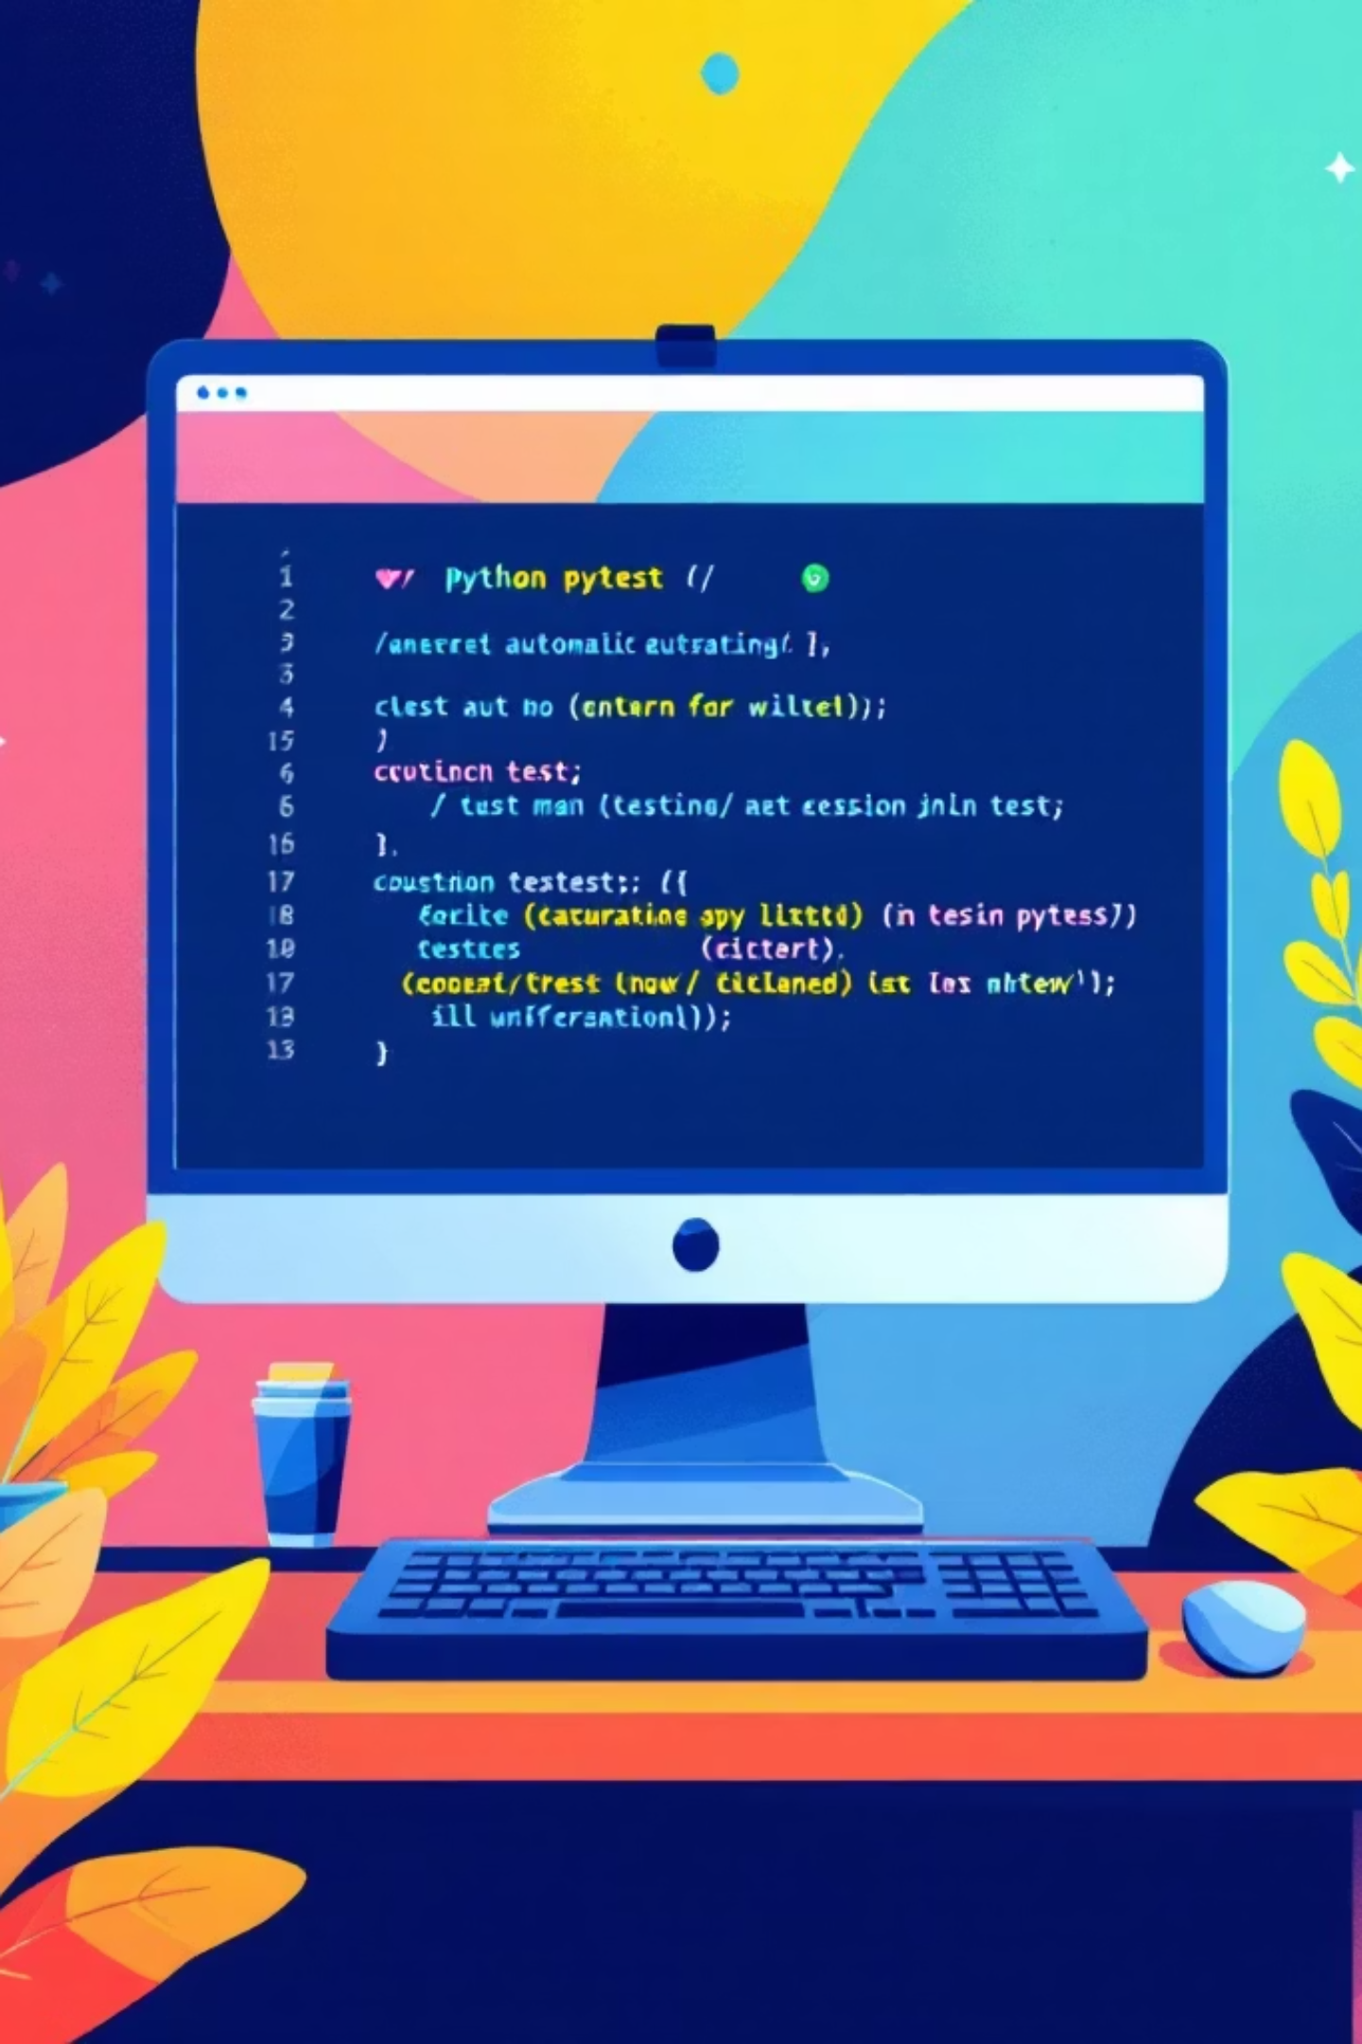

PART 04
API Testing using Pytest
Automated API testing with the Pytest framework for reliable, scalable test coverage.
Test Automation
API Validation
Write and execute automated test cases with Pytest
Validate endpoints, responses, and status codes
CI/CD Integration
Seamlessly integrate tests into deployment pipelines

Slide 34
Objective
Key Activities
To Design And Implement A Scalable Automation Suite For The Foodie App REST APIs Using The Pytest Framework.
Built Automation Framework With Pytest
Automated Modules: Admin, Dish, Restaurant, Order, User
Tools Used
Outcomes
Pycharm, Pytest, Requests Library, Python
Generated Detailed HTML Reports With High Accuracy
Reduced Manual Testing Effort
Improved Understanding Of Automation Design

Slide 35
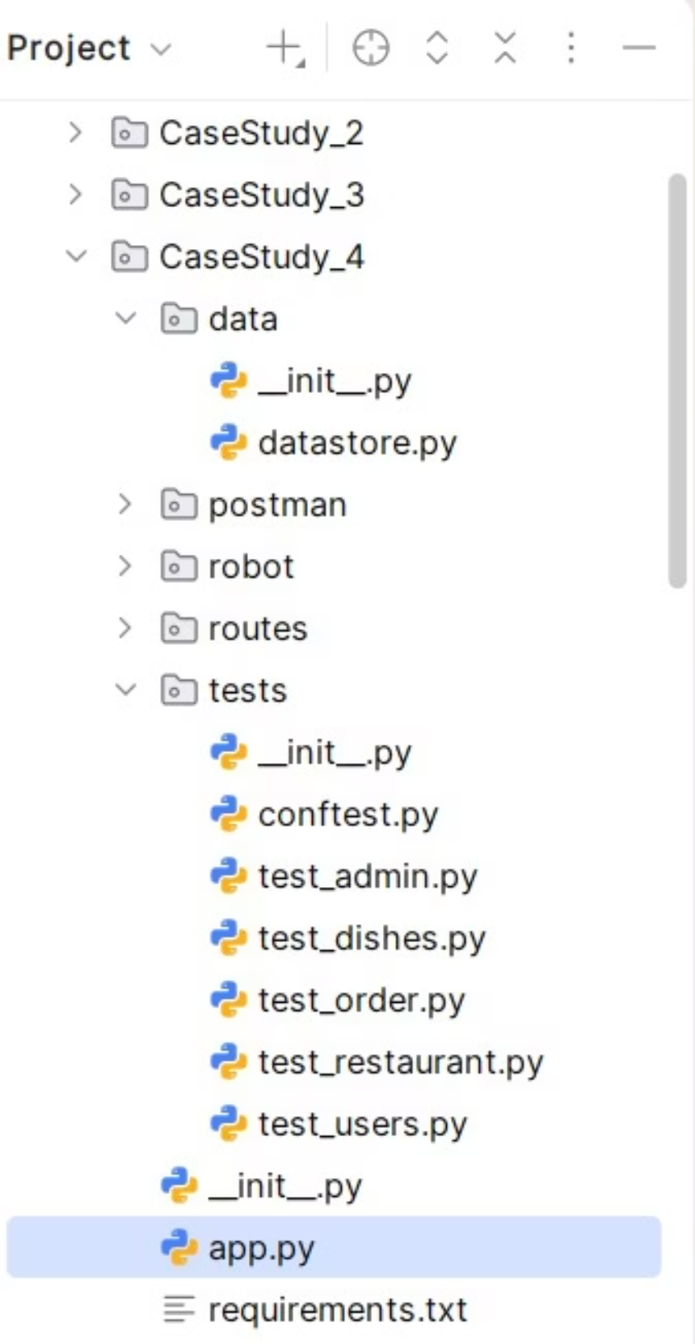




Modules
Restaurant Module
Admin Module
Dish Module
User/Customer Module
Order Module

Slide 36
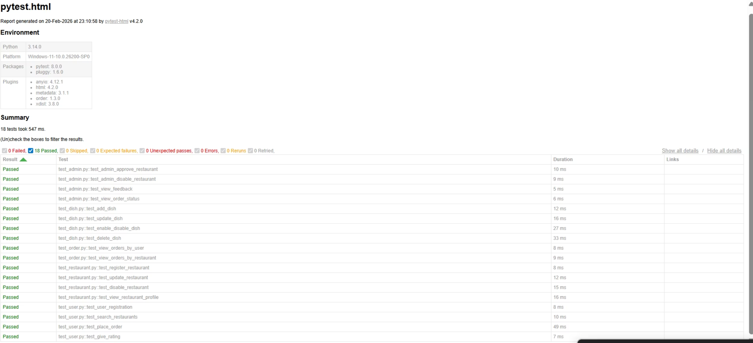
HTML Report

Slide 37
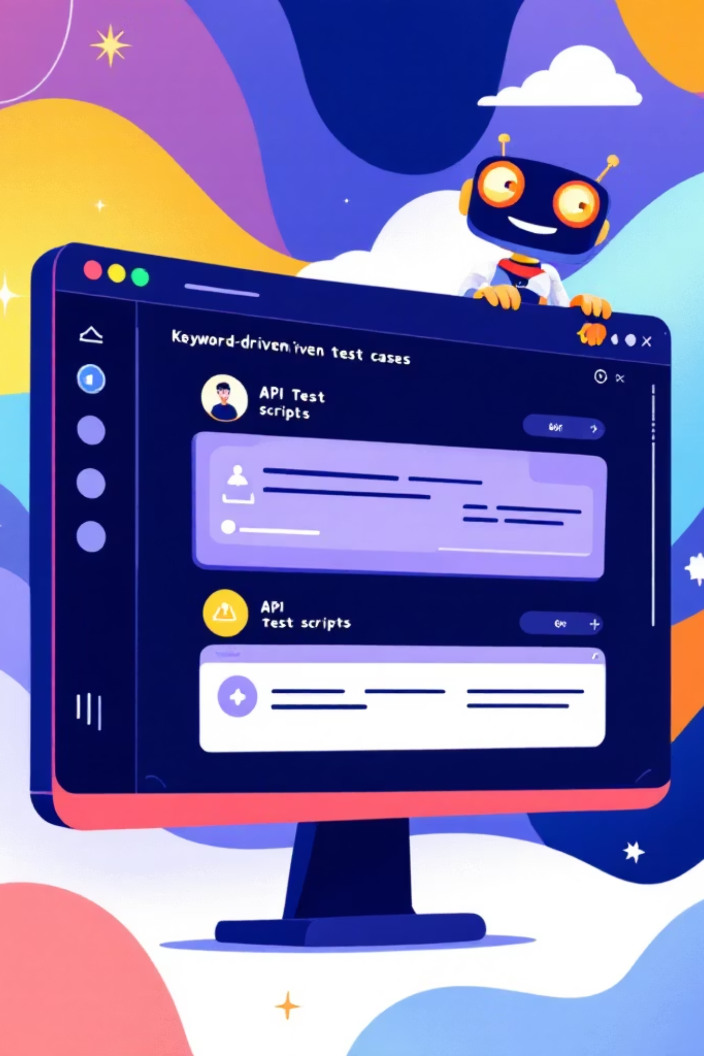
PART 05
API Testing using Robot

Slide 38
Objective
Key Activities
To automate Restaurant Management APIs using Keyword-Driven Testing.
To design a scalable and modular API automation framework.
Designed a modular keyword-driven framework with reusable API keywords and centralized session management using Suite Setup.
Organized test cases module-wise and performed API validation through HTTP status code and response verification.
Tools Used
Outcomes
Pycharm, Robot Framework, Requests Library, Python
Successfully executed all API test cases using Robot CLI.
Generated structured HTML reports and logs.
Achieved reusable and scalable test architecture.

Slide 39
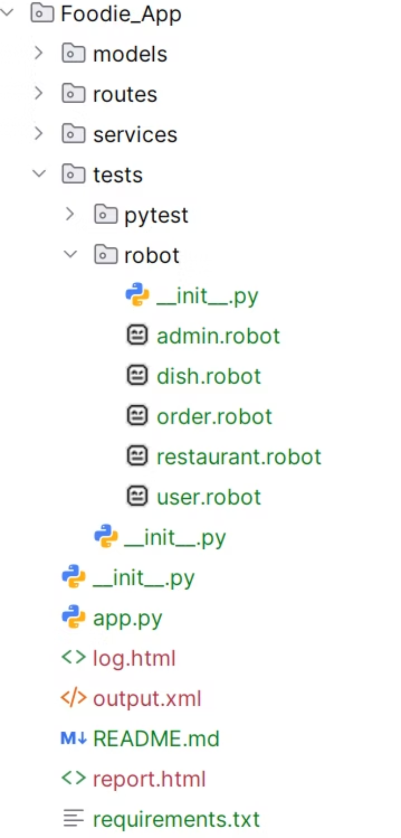

Modules
Restaurant Module
Admin Module
Dish Module
User/Customer Module
Order Module

Slide 40
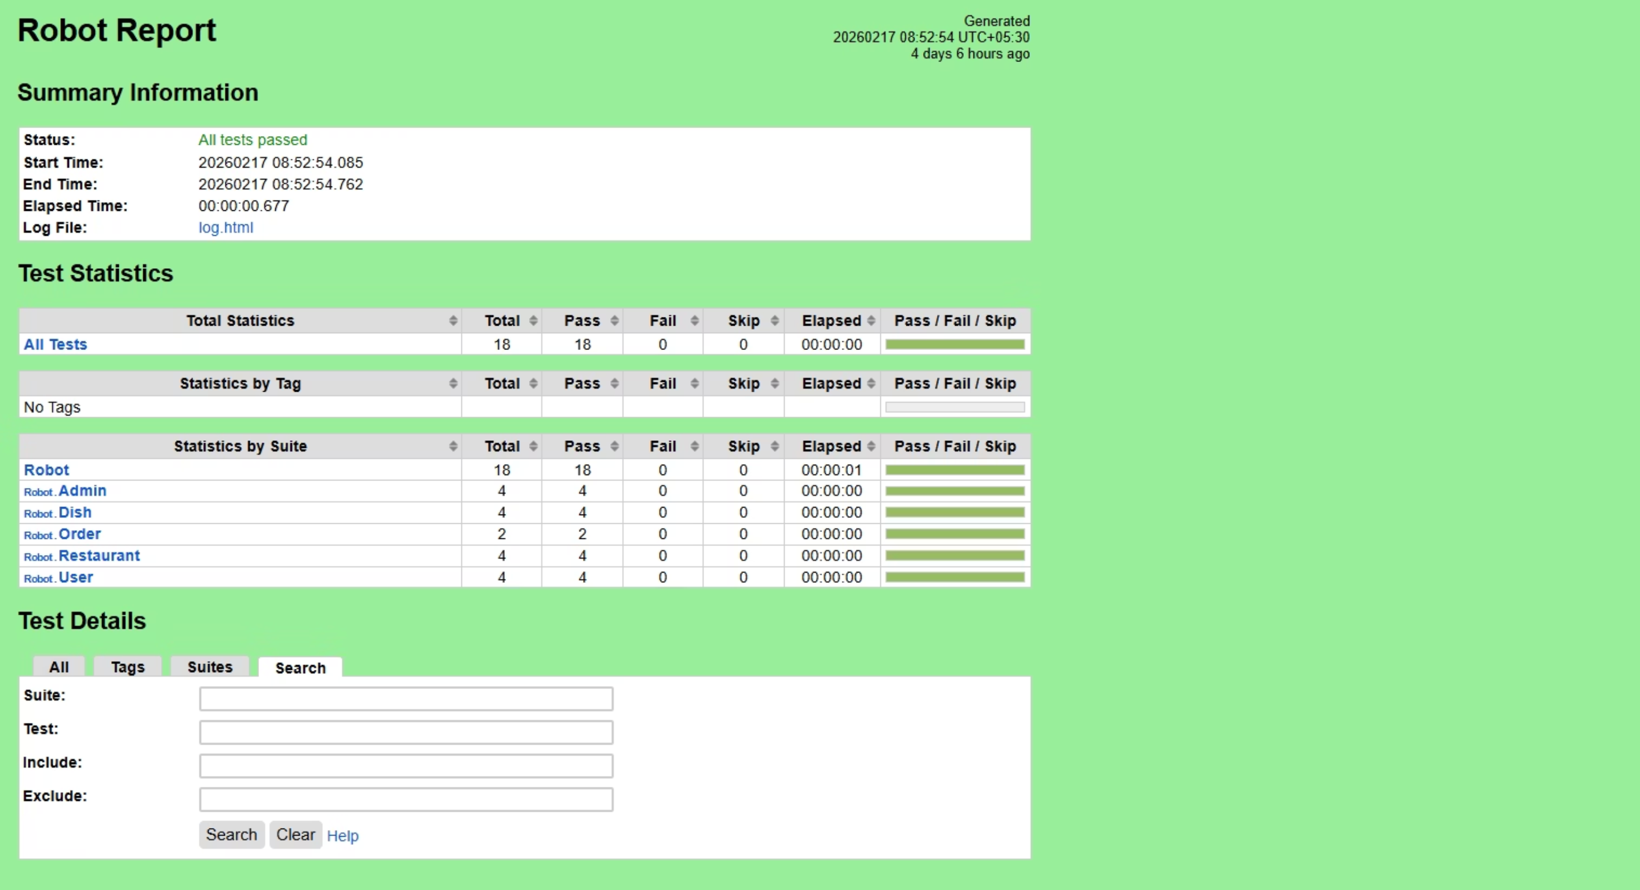
HTML Report

Slide 41
API Testing: Challenges & Solutions
⚠️ Challenges
✅ Solutions
Parameter Combination
No GUI Available
Structured Test Design
API Testing Tools
Difficult to give input values without a graphical interface to test the application.
Use boundary value analysis and equivalence partitioning to manage parameter combinations effectively.
Leverage tools like Postman, or REST-Assured to simulate input values without a GUI.
Managing complex combinations of parameters, their selection, and proper call sequencing.
Documentation & Training
Automated Error Testing
Parameter Categorization
Exception Handling
Exception handling functions need to be thoroughly tested for robustness.
Maintain thorough API documentation and ensure testers are trained on parameter categories.
Implement automated test suites that specifically target exception handling and edge cases.
Parameters selection and categorization required to be known to the testers beforehand.

Slide 42



Conclusion
A summary of what was accomplished throughout the Foodie Application testing project
Full-Stack Test Automation
Multiple Frameworks Implemented
Successfully automated testing across both UI and API layers, covering all modules of the Foodie Application with manual and automated strategies.
Built and optimized automation frameworks using Pytest (Page Object Model), Robot Framework (Keyword-Driven), and Postman for API validation.
Comprehensive Reporting
Enhanced Technical Expertise
Generated detailed HTML reports, logs, and automated screenshots to enhance debugging efficiency and ensure full result transparency.
Deepened hands-on knowledge of end-to-end testing, cross-browser execution, and real-time web and API-based application handling.

Slide 43
THANK
YOU
Group1

